Slide 1
Developing Integration Solutions using Microsoft BizTalk Server 2013
Web Services and WCF

Slide 2

Course Outline
Module 1: Introduction to BizTalk Server
Module 2: Schemas
Module 3: Maps
Module 4: Testing and Deploying BizTalk projects
Module 5: Pipelines
Module 6: Routing
Module 7: Adapters
Module 8: Web Services and WCF
Lesson 1: Introduction to WCF
Lesson 2: WCF and BizTalk
Module 9: Introduction to Orchestrations
Module 10: Applied Orchestration Techniques
Module 11: Business Activity Monitoring
Module 12: Integrating Business Rules
Module 13: Deploying and Managing Applications
Module 14: Windows Azure BizTalk Services

Slide 3
Lesson 1: Introduction to WCF
ABC – Address, Binding, Contract
Sending and receiving a WCF Message
Messaging runtime

Slide 4

The ABC of WCF
Windows Communication Foundation (WCF) is a runtime and a set of APIs for Message Exchange.
A WCF Service can expose one or multiple Endpoints.
Endpoints are defined by 3 elements:
A: Address
B: Binding
C: Contract
C
B
A
A
B
C
WCF
Service
Client
Address
(Where)
Binding
(How)
Contract
(what)

Slide 5

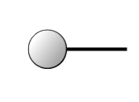


Sending and Receiving a WCF Message
Client
Service
Proxy
Dispatcher
Endpoints
Channel
Channel
Channel
Channel
Channel
Channel
Binding
Encoding
Message
Decoding
Transport
channel
Transport
channel
Notes:
This slide has an animation to briefly show how a client and service communicate:
[Click 1] A service exposes its functionality over one or more endpoints.
[Click 2] A client-side proxy represents one or more of those endpoints that the client can call in a way that is appropriate to its native platform.
[Click 3] Windows® Communication Foundation (WCF) provides a transport channel for communication, encoding for data formatting, and one or more higher-level channels that control security, and transactions. Together these form a binding.
[Click 4] There must be a matching binding on the server side.
[Click 5] The client calls a method on the proxy which is propagated down the channels of the binding until it turns into a message that is sent across to the service.
[Click 6] The message is handled by the service binding in a mirror image of the clientside.
[Click 7] Finally, the message is passed up to the WCF dispatcher, which determines which operation on which service instance the message will be passed to.

Slide 6


Messaging Runtime
Service layer
The WCF Runtime consists of two primary layers:
The Service Layer
Defines API’s and attributes used by developers to define contracts and decorate services with behaviours.
The Messaging Layer
Process a message for transmission on the send side and deliver a message to the dispatcher on the receive side.
The Proxy and Dispatcher are responsible for translating from a .NET method call to a message and vice versa.
Client
Service
Proxy
Dispatcher
Messaging layer
Channel
Channel
Channel
Channel
Channel
Channel
Encoding
Decoding
Transport
channel
Transport
channel
Notes:
This slide has an animation to briefly show how a client and service communicate:
[Click 1] A service exposes its functionality over one or more endpoints.
[Click 2] A client-side proxy represents one or more of those endpoints that the client can call in a way that is appropriate to its native platform.
[Click 3] Windows® Communication Foundation (WCF) provides a transport channel for communication, encoding for data formatting, and one or more higher-level channels that control security, and transactions. Together these form a binding.
[Click 4] There must be a matching binding on the server side.
[Click 5] The client calls a method on the proxy which is propagated down the channels of the binding until it turns into a message that is sent across to the service.
[Click 6] The message is handled by the service binding in a mirror image of the clientside.
[Click 7] Finally, the message is passed up to the WCF dispatcher, which determines which operation on which service instance the message will be passed to.
Try not to explore this slide too fully. All of these topics will be covered in more detail later in the course. For example, the inner workings of bindings will be discussed in more detail.

Slide 7
Lesson 2: BizTalk and WCF
BizTalk and WCF
WCF Adapters
Demonstration: Configuring the In-Process netTcpAdapter
Demonstration: Configuring the Isolated basicHttpAdapter
Demonstration: Configuring the WCF-Custom SQL Adapter
Wizards
Publish a service or metadata endpoint
Consume service metadata

Slide 8
BizTalk and WCF
WCF Receive Adapters
Allow clients to use WCF endpoints to submit messages to BizTalk
HTTP based adapters are (by default) Isolated (run in W3WP.exe)
Adapter input is generic, asynchronous and untyped
WCF Send adapters
Like receive adapters, don’t change the basic architecture of BizTalk
Send Ports are message-type agnostic
Configuration stored with Receive Location or Send Port instead of application configuration file

Slide 9


Getting a WCF Message into BizTalk
Receive Port
Receive Location
Adapter
Service
Message is received by the service
The transport channel retrieves the stream of bytes and creates a WCF Message to be processed through the channel stack
The WCF message is passed to the Dispatcher
The message is passed to the BizTalkServiceInstance
Based on the Receive Location configuration, the relevant part of the message is extracted to create a BizTalk message
The message is passed to the pipeline
The message is passed to any configured map
The message is published to the MessageBox
Transport channel
Decoding
Channel
Channel
Channel
Dispatcher
BizTalkServiceInstance
Body/Envelope/XPath
Pipeline
Map
Message Box

Slide 10
WCF Receive Adapters
Adapter | Host Type | Description
WCF-NetTcp | In-process | Uses the WCF NetTcpBinding, allows integration with WCF clients
WCF-NetNamedPipes | In-process | Uses the WCF NetNamedPipesBinding, allows fast communication to same machine services
WCF-WsHttp | Isolated | Uses the WCF WsHttpBinding, allows integration with compatible WS-* stacks
WCF-BasicHttp | Isolated | Uses the WCF BasicHttpBinding, allows integration with WS_BaseProfile1 compatible stacks
WCF-NetMsmq | In-process | Uses the WCF NetMsmqBinding, allows integration with WCF MSMQ clients
WCF-Custom | In-process | Allows you to use any Binding hosted by BizTalk
WCF-CustomIsolated | Isolated | Allows you to use any Binding in an Isolated Host
Notes:
Each are equivalents to the OOB WCF bindings

Slide 11
Receive Adapter Configuration
All (non custom) adapters have four configuration areas in common
General
URI and endpoint identity
Binding
Whatever configuration can be done for binding (=adapter).
Only valid configurations are possible – interface built to fit binding.
Security
Configure SecurityMode and settings for that.
Only valid configurations are possible – interface built to fit binding.
Message
Determine what part of WCF message to create BizTalk message out of.

Slide 12
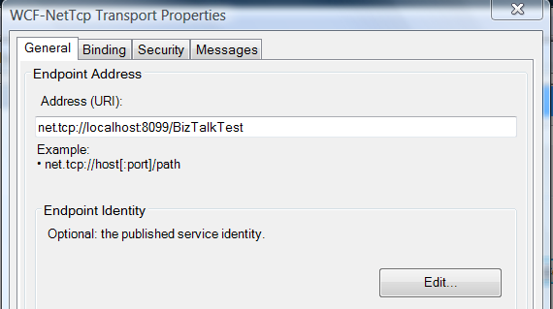
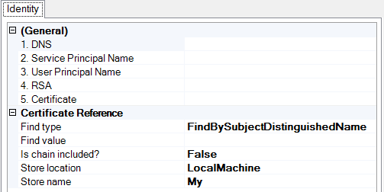
General
URI can be complete or relative, depending on adapter.
General Tab (NetTcp)

Slide 13
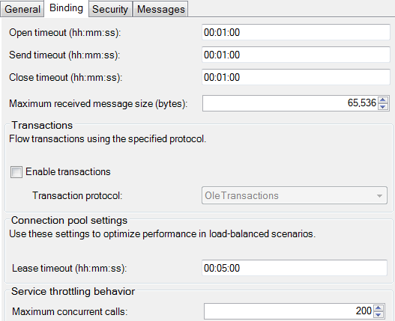
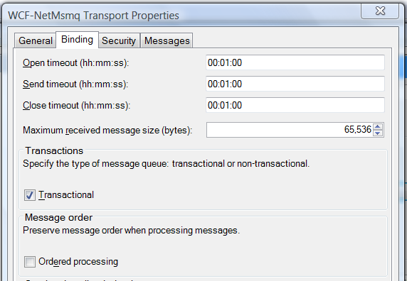
Binding
Transaction
Only enabled for One-Way Receive Locations
Holds true for all WCF adapters that support transactions
Transaction to MessageBox will be joined with flowed transaction
Binding Tab (NetTcp)

Slide 14
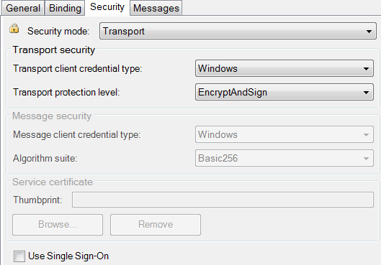
Security
Basically the same as raw WCF configuration
UI does enforce validation
Generally Transport (the default) is the most performant
Transport is point-to-point
Message is end-to-end
Can enable SSO if a Windows Principal will be available
Security Tab (NetTcp)

Slide 15
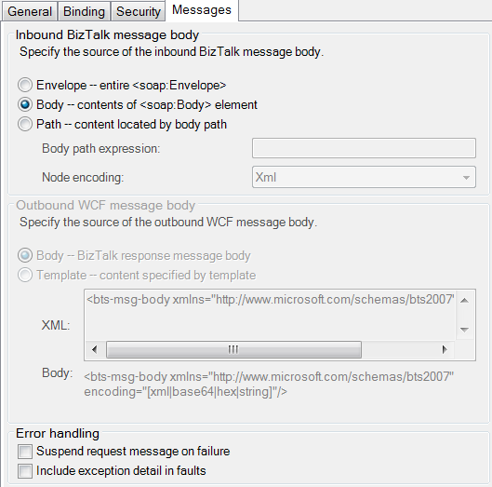
Message
Body – default
The child of the soap:Body element
Envelope
Whole soap:Envelope element is published to the MessageBox
No processing (if signed/encrypted it will keep those attributes)
XPath
Valid XPath expression relative to soap:Body
Outbound – if request/response
Can optionally specify a template
Use bts-msg-body element to place message body

Slide 16

Demo
Using a WCF Receive Adapter
Configuring the netTcpAdapter
Notes:
(Slide 16)

Slide 17
WCF-Custom/CustomIsolated adapters
The WCF-Custom and WCF-CustomIsolated adapters offer you complete control over the channel stack and behaviors configuration
Similar to “normal” WCF configuration
The WCF-Custom/WCF-CustomIsolated Adapters allow to:
Implement and exploit extensibility points.
Have full access to properties exposed by bindings/behaviors.
Export/Import the binding configuration.
Run an http-based adapter within an in-process host.
Use bindings (e.g. sqlBinding) for which a WCF Adapter does not exist.
Have errors ‘Disable location on failure’
They are the only WCF adapters you really need.

Slide 18
WCF Send Adapters
WCF adapter Send Port configuration almost identical to Receive Location
Remember WCF uses the same programming model on both sender and receiver
Adapter | Host Type | Description
WCF-NetTcp | In-process | Uses the WCF NetTcpBinding, allows integration with WCF clients
WCF-NetNamedPipes | In-process | Uses the WCF NetNamedPipesBinding, allows fast communication to same machine services
WCF-WsHttp | In-process | Uses the WCF WsHttpBinding, allows integration with compatible WS-* stacks
WCF-BasicHttp | In-process | Uses the WCF BasicHttpBinding, allows integration with WS_BaseProfile1 compatible stacks
WCF-NetMsmq | In-process | Uses the WCF NetMsmqBinding, allows integration with WCF MSMQ clients
WCF-Custom | In-process | Allows you to use any Binding hosted by BizTalk
WCF-CustomIsolated | In-process | Allows you to use any Binding in an Isolated Host

Slide 19
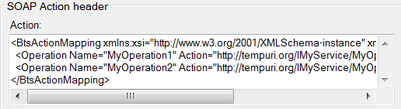
Action Mapping
General Tab
Send Adapter needs correction Action header for outgoing call
Operation name must be found in Message Context
Automatic for messages from Orchestration
Mapping generated by wizard
Must generate by hand if not using wizard

Slide 20
Propagate fault message
Each Send Adapter has this setting
For Solicit-Response Send Ports only
Check (default) fault messages are routed to the subscriber
Uncheck – normal BizTalk Nack message is sent
Orchestration Port delivery notification can kick in
MessagesTab

Slide 21
Outbound credentials
All WCF Send Adapters (except WCF-NetNamedPipes) support using SSO
UI either on Credentials tab (WCF-WsHttp, WCF-BasicHttp) or Security (WCF-NetTcp, WCF-NetMsmq) tab
Can configure single username/password combination as well
Enabled only when username credentials would work
Except WCF-Custom

Slide 22
Demo
Using a WCF Send Adapter
Configuring the netTcpAdapter
Notes:
(Slide 22)

Slide 23
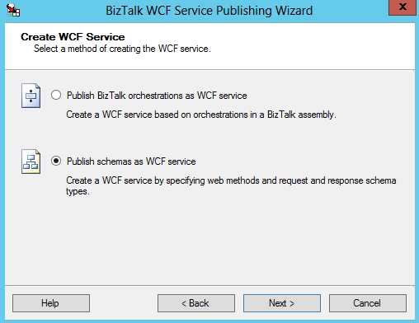
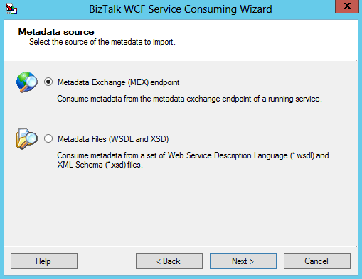


Wizards
WCF Consuming Wizard
WCF Publishing Wizard

Slide 24
BizTalk WCF Service Publishing Wizard
Generates WCF based ASP.NET application and virtual directory
Based on metadata from
Public PortTypes from an Orchestration assembly
Schema types from a BizTalk Assembly

Slide 25
Wizard generated files
*.svc file
Links svc endpoint to ServiceHost/ServiceHostFactory
ServiceDescription.xml
BizTalk specific file - holds description of endpoint for metadata
Web.config
ASP.NET configuration file with BizTalk specific elements
Notes:
Demo: Using WCF publishing wizard to expose a 2-way port as an endpoint using MEX setting and then run svcutil against WSDL to review how it gets exposed to WCF (.svc)
.svc - WCF adds special http handlers for IIS to deal with .svc file. Endpoint/URI in .svc file and Service.cs is the exposed WCF service

Slide 26
Mex endpoint only
It can also create just a metadata endpoint
Useful for the in-process adapters
Still based on Orchestration or Schema
Use to create metadata endpoint for In-process Adapters
Notes:
MEX - Metadata only endpoint
Note: MEX doesn’t limit what client can post but does provides metadata endpoint for clients to run svcutil or Add a Service… against to get the client binding config and proxy classes for calling in

Slide 27
In-process adapter metadata
None of the in-process adapters have metadata endpoints exposed
Possible with WCF-Custom
But ends up being loosely typed based on BizTalkServiceInstance
WCF Wizard can generate mex only Web Application Endpoint
Based on Orchestration or Schemas
Using SvcUtil.exe and manually distributing metadata is also possibility
Notes:
MEX - Metadata only endpoint

Slide 28
WCF Service Consuming Wizard
Generates all the BizTalk artifacts necessary for calling a services
Can be used against any Web Service definition (WSDL) not just WCF
Can retrieve metadata online (from url) or offline (local files)
Orchestration or Messaging can be configured manually as well
Notes:
WCF send ports have no way to choose a Contract. It is loosely typed and uses your messages in BizTalk. So this is the reason for the WCF Service consuming wizard.

Slide 29
Generated artifacts
Schema *.xsd file
Number depends on imported metadata
Orchestration *.odx file
Port Types
Binding files
One or two
Multipart messages
One if WSDL matches existing adapter
One for WCF-Custom

Slide 30
Demo
BizTalk WCF Wizards
Consuming a service from BizTalk
Publishing a schema as a service
Notes:
(Slide 30)

Slide 31
Summary
Why focus so much on WCF adapters?
Hardest to understand
Newest addition to BizTalk
Investments for the future
It’s all about webservices
ESB and SOA are no longer just buzzwords in the integration space

Slide 32
Q & A
Web Service and WCF

Slide 33

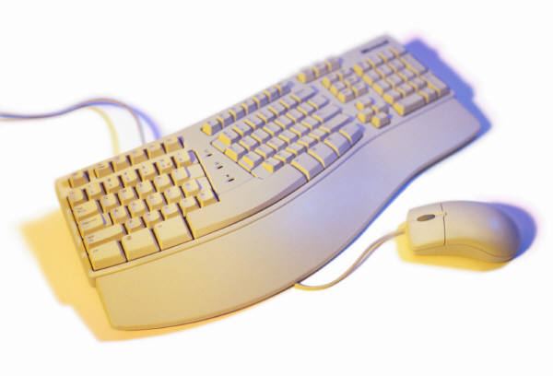
Hands-On-Labs
Using the WCF Adapters in BizTalk Server
Configure WCF Adapters
Consuming a WCF Service
Exposing a WCF Service

Slide 34

Quiz
What is the ABC of WCF?
Name a few of the BizTalk WCF Adapters.
When would you use the BizTalk WCF Service Publishing Wizard?
When would you use the BizTalk WCF Service Consuming Wizard?

